Slide 1
Lab6 form validation

Slide 2
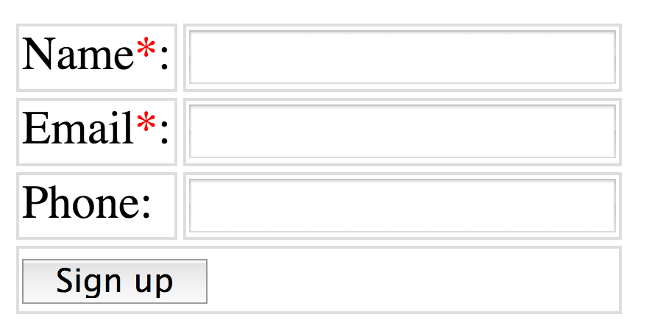
Your lab6.html page should contain 2 forms
The first form looks like this.

Slide 3
The first form requirement requirements
Alert user when the (name or email) input is empty.
Alert user the email input is illegal format.
Alert user all information is validated when the above criteria is satisfied.

Slide 4
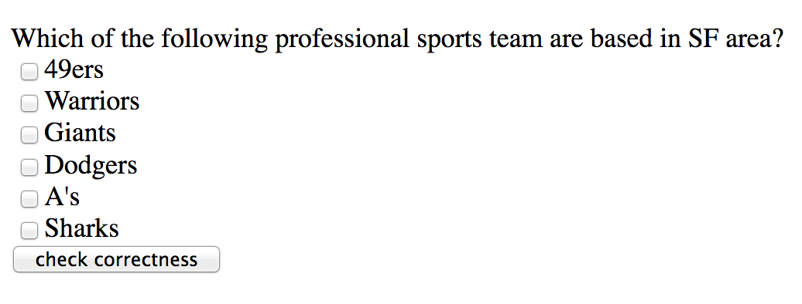
The second form looks like this.

Slide 5
The second form requirements
The correct selection is 49ers, Warriors, Giants, A’s Sharks
If only some of them are selected, you alert the user it’s partially correct.
If dodgers being selected, alert incorrect

